Slide 1

Machine Learning
ICT-4261
By-
Dr. Jesmin Akhter
Professor
Institute of Information Technology
Jahangirnagar University

Slide 2
Contents
The course will mainly cover the following topics:
A Gentle Introduction to Machine Learning
Important Elements in Machine Learning
Linear Regression
Logistic Regression
Naive Bayes
Support Vector Machines
Decision Trees and Ensemble Learning
Neural Networks and Deep Learning
Unsupervised Learning

Slide 3
Outline
Decision Trees and Ensemble Learning
Notes:
https://iq.opengenus.org/cart-algorithm/

Slide 4
What is Decision Tree Pruning and Why is it Important?
Pruning is a technique that removes the parts of the Decision Tree which prevent it from growing to its full depth. The parts that it removes from the tree are the parts that do not provide the power to classify instances.
A Decision tree that is trained to its full depth will highly likely lead to overfitting the training data - pruned trees tend to be smaller therefore Pruning is important.
Pruning is essential for mitigating overfitting in decision trees by selectively removing tree parts, reducing complexity, thus, easier to comprehend and is usually faster
They are better at correctly classifying independent test data (i.e., of previously unseen tuples) than unpruned trees that is enhancing adaptability to new data without sacrificing predictive accuracy.
In simpler terms, the aim of Decision Tree Pruning is to construct an algorithm that will perform worse on training data but will generalize better on test data.
Notes:
Pruning is a data compression technique in machine learning and search algorithms that reduces the size of decision trees by removing sections of the tree that are non-critical and redundant to classify instances. Pruning reduces the complexity of the final classifier, and hence improves predictive accuracy by the reduction of overfitting.

Slide 5
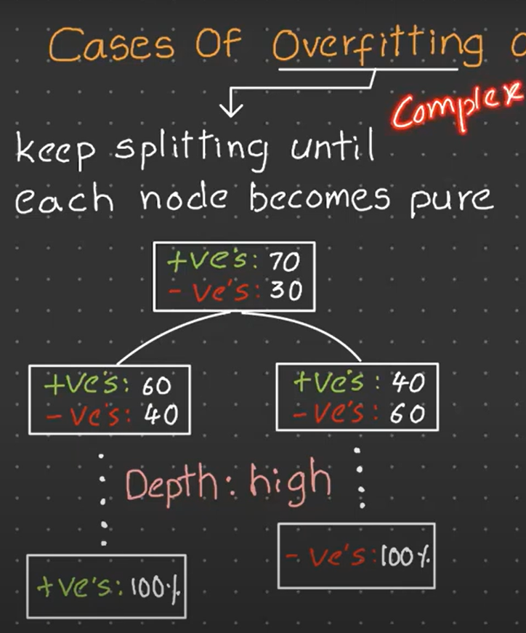
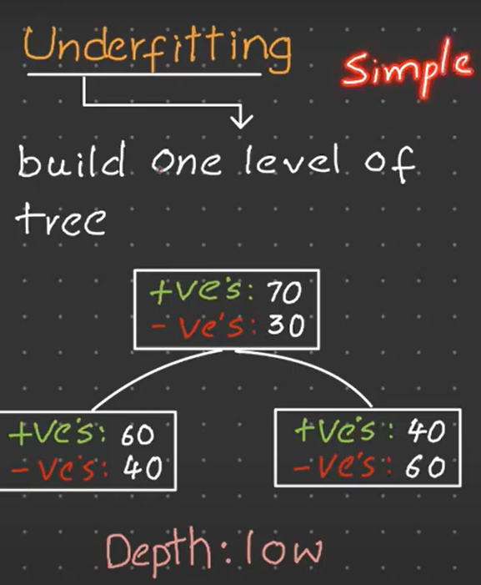
Notes:
Underfitting -Single feature case

Slide 6
How do you Prune a Decision Tree?
There are two types of pruning: Pre-pruning and Post-pruning. I will go through both of them and how they work.
Pre-pruning
The pre-pruning technique of Decision Trees is tuning the hyperparameters prior to the training pipeline. It involves the heuristic known as ‘early stopping’ which stops the growth of the decision tree - preventing it from reaching its full depth.
It stops the tree-building process to avoid producing leaves with small samples. During each stage of the splitting of the tree, the cross-validation error will be monitored. If the value of the error does not decrease anymore - then we stop the growth of the decision tree.
The hyperparameters that can be tuned for early stopping and preventing overfitting are:
max_depth, min_samples_leaf, and min_samples_split
These same parameters can also be used to tune to get a robust model. However, you should be cautious as early stopping can also lead to underfitting.
Notes:
While on the start point of making a tree, we decide particular node should be part of a tree or not. If that node seems not required it will replace with “Leaf Node”.
Post pruning decision trees is more mathematically rigorous, finding a tree at least as good as early stopping. Early stopping is a quick fix heuristic.

Slide 7
Pre- Pruning Techniques -
There are several strategies for pruning:
These all techniques are “hyperparameters” of the “Decision Tree”
1. Maximum Depth:-
It reduces the depth of the tree. It is one of the simplest forms of pre-pruning. So starting only will decide the number of max_depth so the tree won't grows after the given depth.
If Max_depth is “None” — Overfit
If max_depth is “1” — Underfit
Clearly a “Bias variance trade-off” happening so we need to provide a value of max_depth which is not very less or max.

Slide 8
Pre- Pruning Techniques -
2. Minimum Sample Split:-
This is a condition where a node only be split if the number sample of that node is above a certain threshold. If the number of samples is too small, then the node is not split and become a leaf node instead. This can prevent overfitting by not allowing the model to learn noise in the data.
Choosing the number wisely is important. This number of samples should not be very high - tree will be very small.
Here we control on “decision node level/ “Parent level”
3. Minimum Sample Leaf:-
This condition requires that a split at a node must leave at least a minimum number of training examples in each of the leaf nodes. Like the minimum sample split, this strategy can prevent overfitting by not allowing the model to learn from noise in the data.
Based on the given sample leaf.
Ex- if sample leaf has given 50 then after this number won't split further.
Here we control on “leaf level/ “child level”

Slide 9
ADVANTAGE AND DISADVANTAGE OF PRE- PRUNING
1. Simplicity –Pre- Pruning criteria such as maximum depth or minimum number of samples per leaf are easy to understand and implement.
2. Computational Efficiency - By limiting the size of tree, pre pruning can substantially reduce the computational cost of training and prediction.
3. Reduced Overfitting- This technique we only use for this reason.
DISADVANTAGE OF PRE-PRUNING:
1. Underfitting risk-
If max_depth = 3 then how we get to know that model reduce overfitting or convert into underfit. So there is no quantific analysis to measure which direction it will go. No mathematical equation to check the measure.
2. Requires Fine Tuning-
How can we decide which range is right to choose.
The pre- pruning parameters like max_depth , minimum_sample_leaf often require careful tuning to find the right balance between underfitting and overfitting.

Slide 10
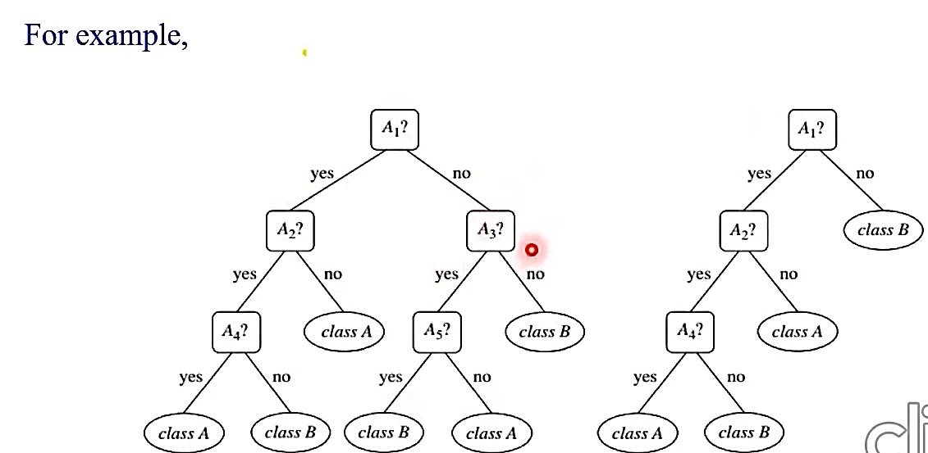
Post-pruning
Post-pruning does the opposite of pre-pruning and allows the Decision Tree model to grow to its full depth. Once the model grows to its full depth, tree branches are removed to prevent the model from overfitting.
The algorithm will continue to partition data into smaller subsets until the final subsets produced are similar in terms of the outcome variable. The final subset of the tree will consist of only a few data points allowing the tree to have learned the data to the T. However, when a new data point is introduced that differs from the learned data - it may not get predicted well.
The hyperparameter that can be tuned for post-pruning and preventing overfitting is:
ccp_alpha: ccp stands for Cost Complexity Pruning and can be used as another option to control the size of a tree.
A higher value of ccp_alpha will lead to an increase in the number of nodes pruned.

Slide 11
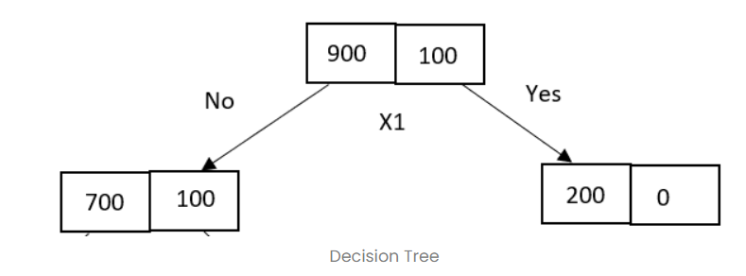
Consider 900 “positive” samples and 100 “negative” samples. Let’s assume the X1 attribute is used for splitting at the parent node. Consider the following decision tree with unequal distribution of data samples after splitting.
It has one pure node classified as 200 “positive” samples and an impure node with 700 “positive” and 100 “negative” samples.

Slide 12
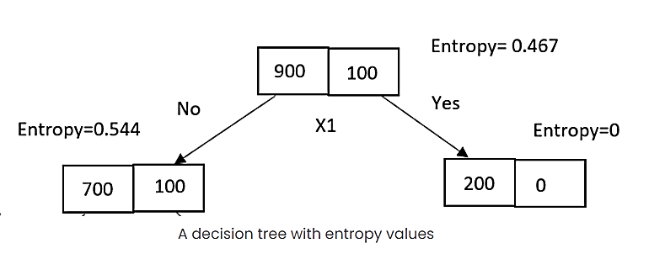
With entropy as a loss function, parent loss is 0.467, and children loss is 0.544. As one node is pure, the entropy is zero, and the impure node has a non-zero entropy value.
Using the information gain formula, the loss reduction from parent to children region is calculated as,
Gain = Entropy(parent) — [Entropy(left child)*(No of samples in left child/No of samples in parent) + Entropy(right child)*(No of samples in right child/No of samples in parent)]
Gain = 0.467 –[0.544*(800/1000) + 0 *(200/1000)]
Gain = 0.0318

Slide 13
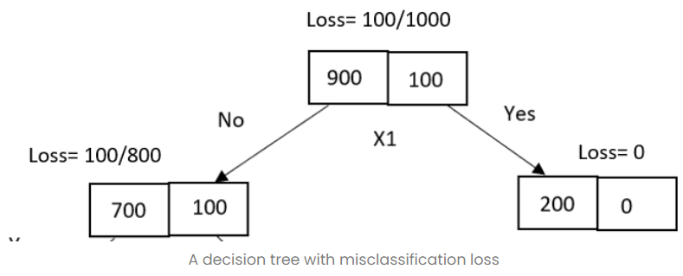
With a misclassification error, parent loss is 0.1, and children loss is 0.125.

Slide 14
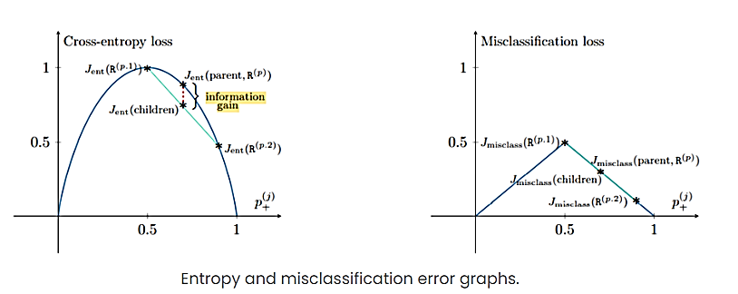
The information gain is calculated as,
Gain = ME(parent) — [ME(left child)*(No of samples in left child/No of samples in the parent) + ME(right child)*(No of samples in right child/No of samples in the parent)]
Gain = (100/1000) — [(100/800)*(800/1000) + 0*(200/1000)]
Gain =0
From the above gain values, we can say that as the misclassification error has not gained any information hence, further splitting of the tree is not required, and the decision tree is stopped growing. But in the case of entropy, the decision tree can be partitioned further until the leaf node is reached and the entropy value becomes zero.
Let’s prove this with a geometrical perspective.

Slide 15
The above graphs are plotted with the assumption of an even split of data into two nodes. The cross-entropy function has concave nature that proves the loss of children is always less than that of the parent. But this is not the case with the misclassification error. Hence the children and parent loss are equal.
Therefore, compared to entropy, the misclassification loss is not sensitive to changes in the class probabilities, due to which entropy is often used in building the decision tree for classification.
The Gini impurity has the same nature as entropy which is also preferred for decision tree building over misclassification loss.

Slide 16
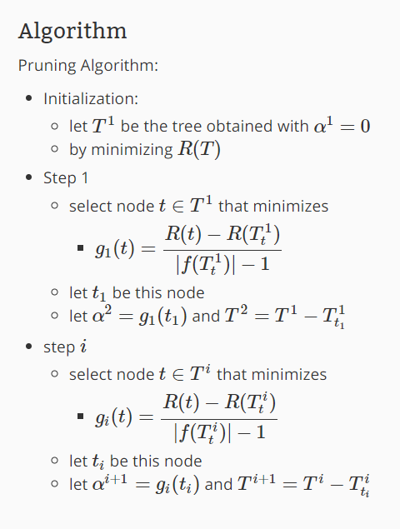
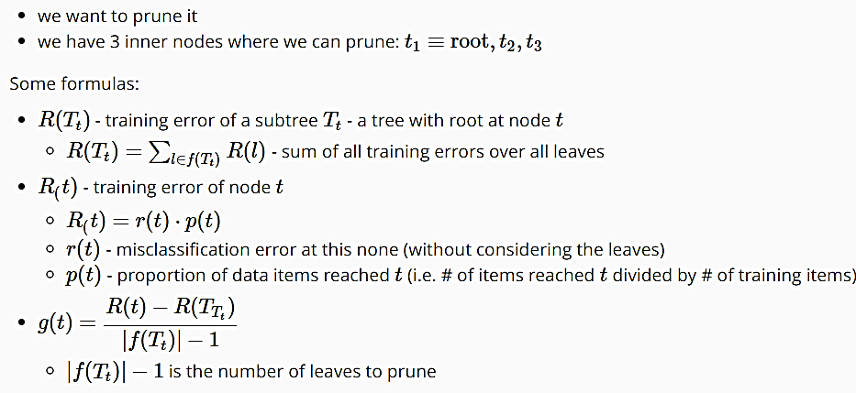
Notes:
http://mlwiki.org/index.php/Cost-Complexity_Pruning

Slide 17
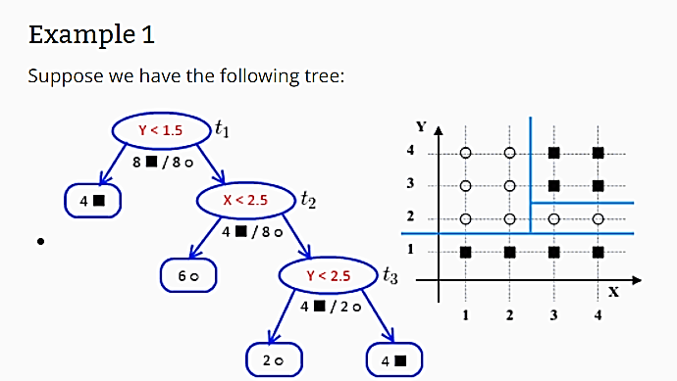


Slide 18
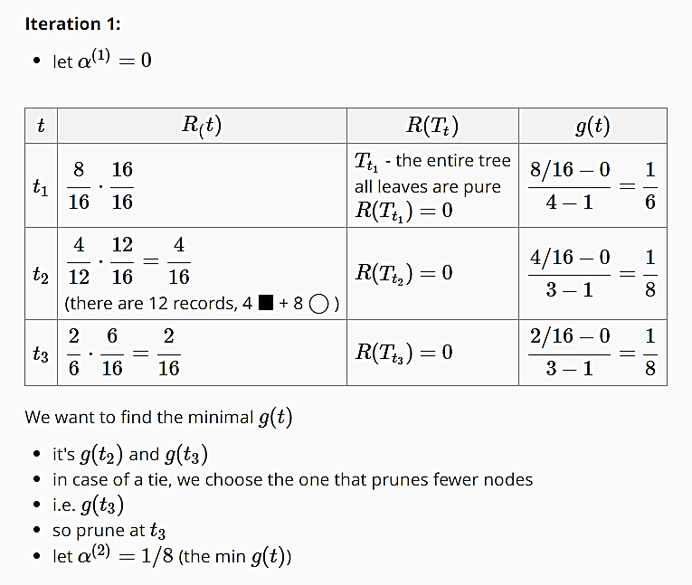
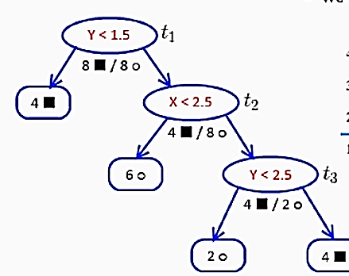

Slide 19
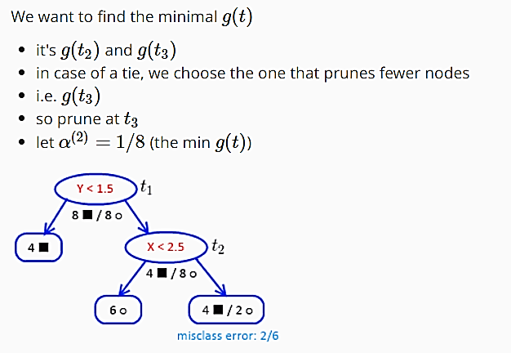

Slide 20
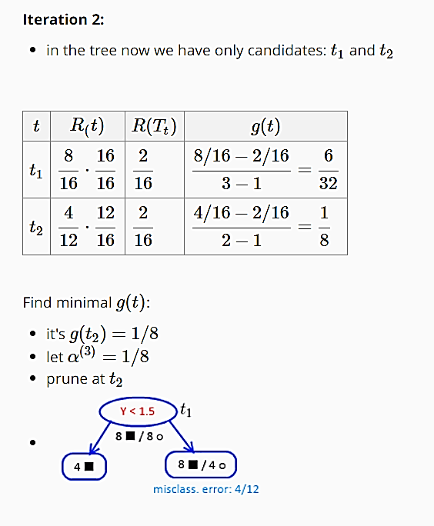

Slide 21
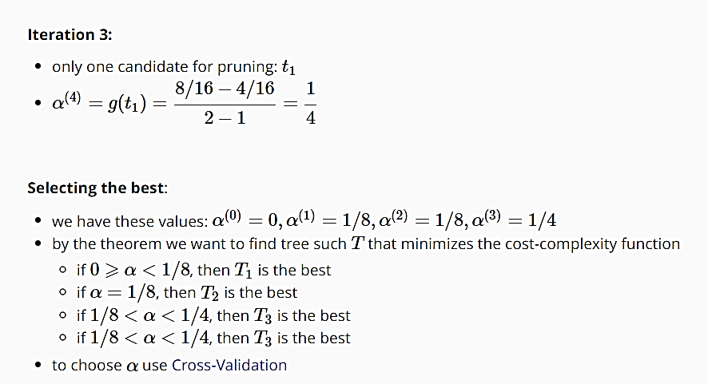

Slide 22
Assignment
Submission date
04/04/2024

Slide 23
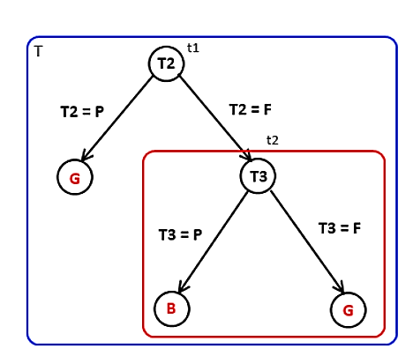
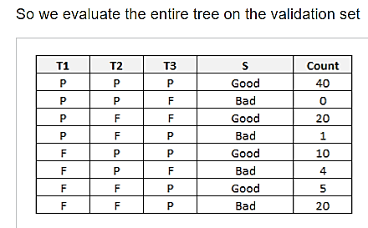

Slide 24
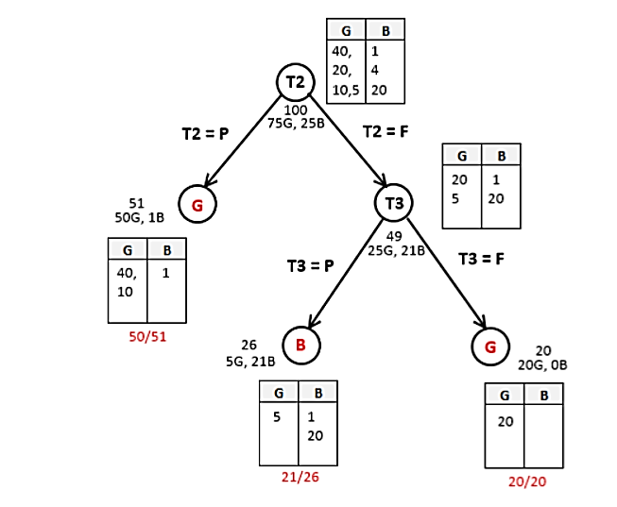
54
50G 4B
46
4
50/54

Slide 25
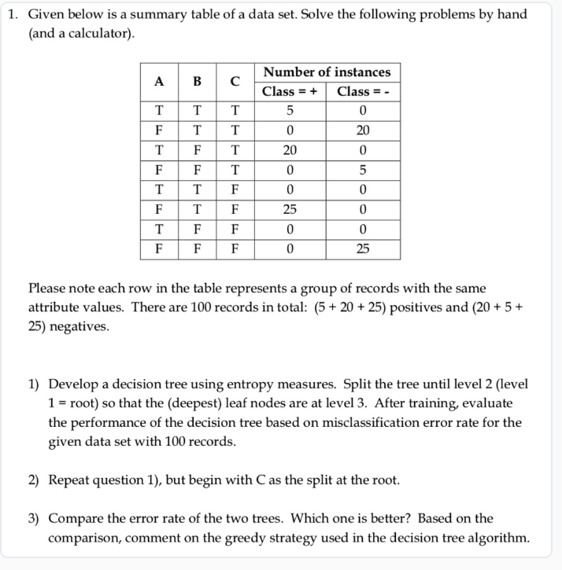
1) Train a DT using entropy measures. Split the DT until level 2 (root at level 1) so that the (deepest) leaf nodes are located at level 3. After training the tree, calculate the total misclassification error rate of the DT on the same train set (i.e., resubstitution error).
2) Repeat part 1, but fix C as the split criterion at the root node and grow the rest of the tree.1
3) Compare misclassification rates of the two DTs. Which one is better? Based on the comparison, comment on the greedy strategy used in the DT algorithm.

Slide 26
Step 1/3 1) To develop a decision tree using entropy measures, we need to calculate the entropy for each attribute and choose the attribute with the highest information gain to split the tree. Step 2/3 First, let's calculate the entropy for the initial dataset: - Number of positive instances (Class = +): 5 + 20 + 25 = 50 - Number of negative instances (Class = -): 20 + 5 + 25 = 50 Entropy = - (p+ * log2(p+)) - (p- * log2(p-)) Entropy = - (50/100 * log2(50/100)) - (50/100 * log2(50/100)) Entropy = - (0.5 * log2(0.5)) - (0.5 * log2(0.5)) Entropy = - (0.5 * (-1)) - (0.5 * (-1)) Entropy = 1 Now, let's calculate the information gain for each attribute: - Attribute A: - Number of positive instances (Class = +): 5 + 20 = 25 - Number of negative instances (Class = -): 20 + 5 = 25 - Entropy(A) = - (25/50 * log2(25/50)) - (25/50 * log2(25/50)) - Entropy(A) = - (0.5 * log2(0.5)) - (0.5 * log2(0.5)) - Entropy(A) = - (0.5 * (-1)) - (0.5 * (-1)) - Entropy(A) = 1

Slide 27
Attribute B: - Number of positive instances (Class = +): 0 + 0 = 0 - Number of negative instances (Class = -): 0 + 0 = 0 - Entropy(B) = 0
Attribute C: - Number of positive instances (Class = +): 0 + 0 = 0 - Number of negative instances (Class = -): 0 + 0 = 0 - Entropy(C) = 0
Attribute T: - Number of positive instances (Class = +): 5 + 25 = 30 - Number of negative instances (Class = -): 0 + 25 = 25 - Entropy(T) = - (30/55 * log2(30/55)) - (25/55 * log2(25/55)) - Entropy(T) = - (0.545 * log2(0.545)) - (0.455 * log2(0.455)) - Entropy(T) = - (0.545 * (-0.8)) - (0.455 * (-1)) - Entropy(T) = 0.439 + 0.455 - Entropy(T) = 0.894
Attribute F: - Number of positive instances (Class = +): 0 + 0 = 0 - Number of negative instances (Class = -): 20 + 25 = 45 - Entropy(F) = - (0/45 * log2(0/45)) - (45/45 * log2(45/45)) - Entropy(F) = - (0 * log2(0)) - (1 * log2(1)) - Entropy(F) = 0

Slide 28
Now, let's calculate the information gain for each attribute:
Information Gain(A) = Entropy - (Weighted Average Entropy(A)) Information Gain(A) = 1 - (50/100 * 1) Information Gain(A) = 1 - 0.5 Information Gain(A) = 0.5
Information Gain(B) = Entropy - (Weighted Average Entropy(B)) Information Gain(B) = 1 - (0/100 * 0) Information Gain(B) = 1
Information Gain(C) = Entropy - (Weighted Average Entropy(C)) Information Gain(C) = 1 - (0/100 * 0) Information Gain(C) = 1
Information Gain(T) = Entropy - (Weighted Average Entropy(T)) Information Gain(T) = 1 - (55/100 * 0.894)
Information Gain(T) = 1 - 0.49
Information Gain(T) = 0.51
Information Gain(F) = Entropy - (Weighted Average Entropy(F)) Information Gain(F) = 1 - (45/100 * 0) Information Gain(F) = 1 Based on the information gain, the attribute with the highest information gain is T. So, we will split the tree based on attribute T. 2)

Slide 29
To repeat the process with C as the split at the root, we need to calculate the entropy and information gain for attribute C.
Attribute C: - Number of positive instances (Class = +): 0 + 0 = 0
Number of negative instances (Class = -): 0 + 0 = 0
Entropy(C) = 0
Information Gain(C) = Entropy - (Weighted Average Entropy(C))
Information Gain(C) = 1 - (0/100 * 0)
Information Gain(C) = 1
Based on the information gain, the attribute with the highest information gain is C. So, we will split the tree based on attribute C. 3

Slide 30
To compare the error rate of the two trees, we need to evaluate the performance of each decision tree based on misclassification error rate.
For the first tree (splitting based on attribute T): - Number of misclassified instances: 5 (Class = +) + 20 (Class = -) = 25 - Misclassification error rate: 25/100 = 0.25 For the second tree (splitting based on attribute C): - Number of misclassified instances: 0 (Class = +) + 0 (Class = -) = 0
Misclassification error rate: 0/100 = 0 Based on the comparison, the second tree (splitting based on attribute C) has a lower error rate of 0 compared to the first tree's error rate of 0.25.

Slide 31
Answer Therefore, the second tree is better in terms of misclassification error rate. The greedy strategy used in the decision tree algorithm involves selecting the attribute with the highest information gain at each step. In this case, the greedy strategy led to the selection of attribute C as the root, which resulted in a better decision tree with a lower error rate. This suggests that the greedy strategy can be effective in finding good splits and building accurate decision trees.

Slide 32
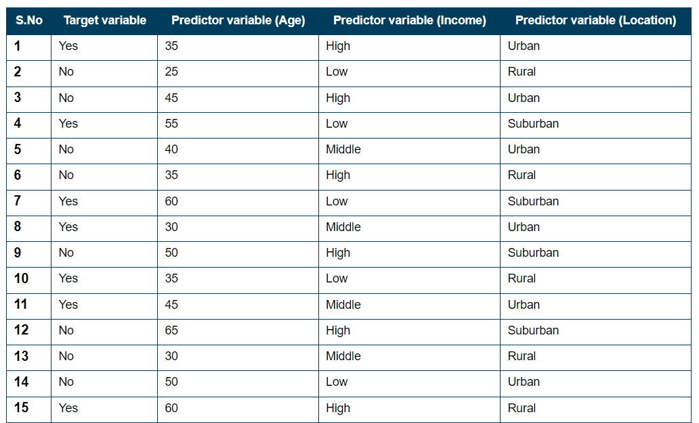
Consider a dataset containing information about customers and their purchasing habits. The target variable is “Will the customer buy the product?”, and the predictor variables are “Age”, “Income”, and “Location”. The dataset is shown:
The decision tree algorithm would use information gain or Gini impurity to determine the best feature to split the data, split the data into subsets based on the values of the selected feature, repeat the process for each subset, and create leaf nodes when a stopping criterion is met. The prediction for the target variable is then made based on the samples in each leaf node.

Slide 33
Q. Does pruning reduce complexity?
Yes, pruning reduces complexity in decision trees by trimming unnecessary branches and nodes. By eliminating redundant splits and reducing the number of leaf nodes, pruning simplifies the tree structure, making it more interpretable and improving its generalization capability.
Q. How to choose α in cost-complexity pruning?
Choosing α in cost-complexity pruning involves finding the value that optimally balances model complexity and predictive accuracy. This can be achieved through techniques such as cross-validation, where different values of α are evaluated on validation data to select the one that minimizes a specified criterion, such as error rate or information gain.

Slide 34
Thank You

Slide 35
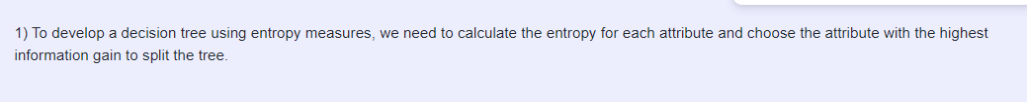
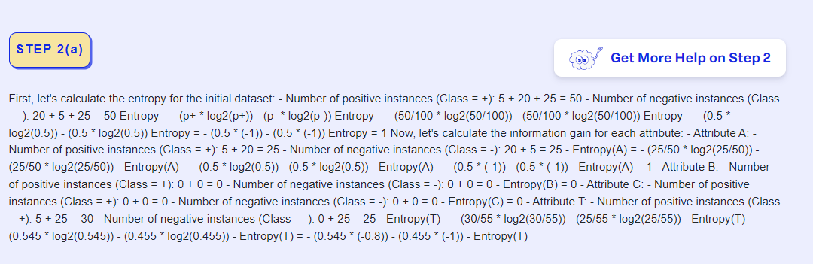

Slide 36
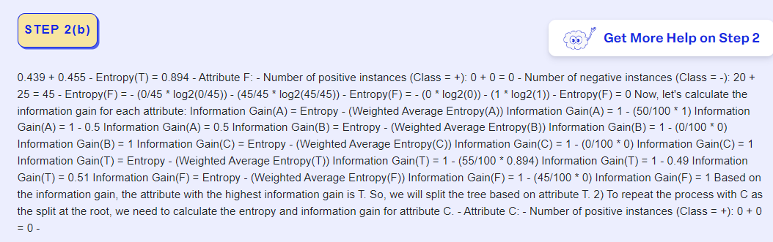

Slide 37
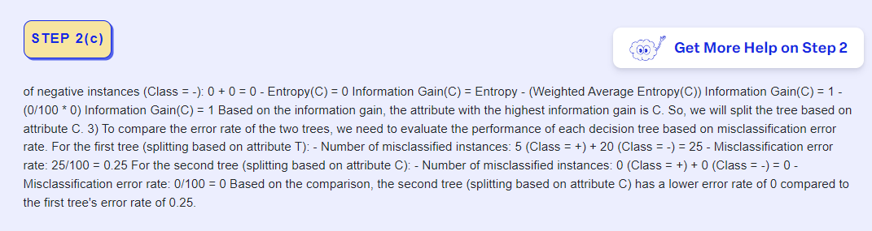
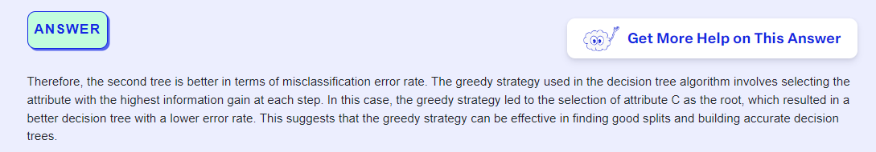

Slide 38
Cost-Complexity Pruning
Cost-complexity pruning is a common method for post-pruning decision trees. It involves assigning a cost to each subtree in the fully grown tree and then selecting the subtree with the smallest cost as the pruned tree. The cost of a subtree is determined by a complexity parameter (often denoted as alpha) and the number of leaf nodes in the subtree.
Calculate Cost for Subtrees: For each subtree, calculate the total error (such as misclassification rate) on the validation data and add a complexity penalty based on the number of leaf nodes and the complexity parameter.
Cost = Error + alpha * (Number of Leaf Nodes)
Select the Best Subtree: Choose the subtree with the smallest cost as the pruned tree.

Slide 39
Example
Consider a decision tree for predicting whether a customer will buy a product based on two features: age and income. The fully grown tree might look like this:
IF age < 30 AND income < 50000
THEN Classify as "Not Buy"
ELSE IF age >= 30 AND income >= 50000
THEN Classify as "Buy"
ELSE IF age >= 30 AND income < 50000
THEN Classify as "Not Buy"
ELSE
THEN Classify as "Buy"

Slide 40
In this example, if the tree is overfitting the data, pruning might occur as follows:
Assign Costs: Subtree 1 (age < 30 and income < 50000):
Error = 5 misclassifications,
alpha = 0.05,
Number of Leaf Nodes = 1,
Cost = 5 + 0.05 *1 = 5.05
Subtree 2 (age >= 30 and income >= 50000):
Error = 2 misclassifications,
alpha = 0.05,
Number of Leaf Nodes = 1,
Cost = 2 + 0.05 *1 = 2.05
Subtree 3 (age >= 30 and income < 50000):
Error = 3 misclassifications,
alpha = 0.05,
Number of Leaf Nodes = 1,
Cost = 3 + 0.05 *1 = 3.05
Subtree 4 (Else):
Error = 4 misclassifications,
alpha = 0.05,
Number of Leaf Nodes = 1,
Cost = 4 + 0.05 *1 = 4.05

Slide 41
Prune Tree: The subtree with the smallest cost (Subtree 2) will be selected for pruning.
The pruned tree would then look like this:
IF age < 30 AND income < 50000
THEN Classify as "Not Buy"
ELSE IF age >= 30 AND income >= 50000
THEN Classify as "Buy"
ELSE
THEN Classify as "Not Buy"
By pruning, the complexity of the tree is reduced, and it becomes less likely to overfit the training data. Pruning is essential to ensure that the decision tree generalizes well to unseen data and makes accurate predictions.

